Slide 1


Fraudulent Job Listings
Building a predictive model
Reid Dial
Jose Colchado
Milo Dufresne-MacDonald

Slide 2

Our Presentation
1
2
3
Data Overview
Building our Model
Model Accuracy
Notes:
General flow of presentation:
Introductions → Data Overview → Cleaning Data → Key Highlights from Analysis → Preparing Data for Modeling → Model Building/Testing/Reiteration → Model Accuracy & What our Model Missed → Overall Conclusions

Slide 3
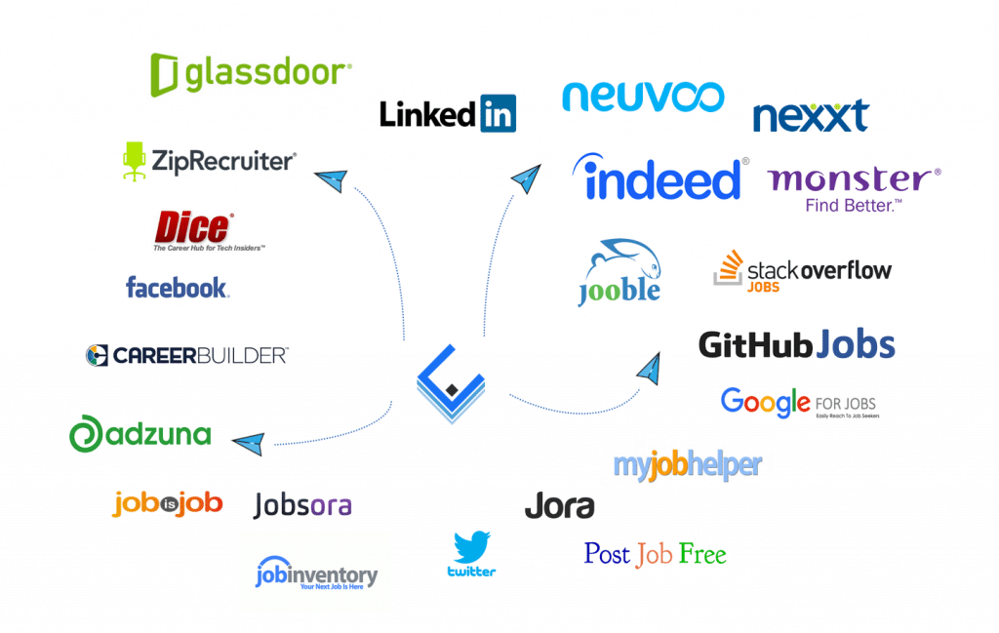

Data Overview
17,800 job listings
(4.84% of listings are fake)
18 Original Columns
Job Title/Description
Industry/Department
Required Experience/Education
Employment Type
Listing Characteristics
Notes:
Our dataset included just under 18,000 job listings, of which around 5 percent were known to be fraudulent. We will discuss how we handled this column in our data later on in the presentation.
Our data originally had 18 columns containing the basic information expected of standard job postings. Additional columns used in building our predictive model will be discussed when relevant.

Slide 4
Missing Values
Column | Percent NaN
Location | 2
Department | 64.5%
Salary Range | 84%
Company Profile | 18.5%
Requirements | 15%
Benefits | 40%
Employment Type | 19%
Required Experience | 39%
Required Education | 45%
Industry | 27%
Function | 36%
Notes:
A majority of our columns included missing values, some with up to 64 or 84% of the rows not having the information. Dropping all NaN values would have left us with a functionally pointless data set

Slide 5
Missing Values
Column | Percent NaN
Location | 2%
Department | 64.5%
Salary Range | 84%
Company Profile | 18.5%
Requirements | 15%
Benefits | 40%
Employment Type | 19%
Required Experience | 39%
Required Education | 45%
Industry | 27%
Function | 36%
NaN → “Not Provided”
Notes:
So instead of dropping NaN values, focusing on these 7 columns, NaN and other similar values representing a lack of information were replaced with “Not Provided”. This was done because missing salary or requirements or even department information on a job listings is universally considered a red flag so this approach ensured our model was given the best information to train on.
However, we had to take a different approach with the Salary Range column

Slide 6
Missing Values
Column | Percent NaN
Location | 2%
Department | 64.5%
Salary Range | 84%
Company Profile | 18.5%
Requirements | 15%
Benefits | 40%
Employment Type | 19%
Required Experience | 39%
Required Education | 45%
Industry | 27%
Function | 36%
NaN → “Not Provided”
Notes:
So instead of dropping NaN values, focusing on these 7 columns, NaN and other similar values representing a lack of information were replaced with “Not Provided”. This was done because missing salary or requirements or even department information on a job listings is universally considered a red flag so this approach ensured our model was given the best information to train on.
However, we had to take a different approach with the Salary Range column

Slide 7
Salary Range
One
Evaluated the Salary Ranges to identify the fake entry points
Two
Developed Max-Min variables that eliminate fake postings
Three
Recalibrated job postings based on probable postings
Four
Configured these job postings towards job types
Notes:
USE THIS SLIDE TO EXPLAIN HOW WE WENT ABOUT CLEANING THE SALARY RANGE COLUMN, WHY WE CHOSE THIS APPROACH, ETC.
[feel free to add in additional slides as necessary, I just thought this step process might be helpful :) ]

Slide 8


Data Highlights
Industries & Departments
Education & Experience
What we do?
Salary
Notes:
TRANSITION SLIDE FOR DATA ANALYSIS HIGHLIGHT
Pull out some highlights for this slide

Slide 9
Top Industries
Real Job Listings
Not Provided- 53%
IT Services - 11%
Electronics - 9%
Education- 6%
Finance - 6%
Fraudulent Job Listings
Not Provided - 68%
Finance - 11%
IT Services - 6%
Marketing - 5%
Real Estate - 3%
IT Services and Finance Industries make up 16% of dataset
Notes:
Maybe for this and the next slide, we could combine them to be one slide with a table, one for real job postings and one for fake job postings?

Slide 10
Top Departments
Real Job Listings
Not Provided - 79%
Sales - 3%
Engineering - 3%
Marketing - 2.5%
IT - 2%
Fraudulent Job Listings
Not Provided - 83.5%
Engineering- 6.5%
IT - 2%
Customer Service- 2%
Administrative - 2%
Engineering and IT Industries make up 5% of dataset
Notes:
Maybe for this and the next slide, we could combine them to be one slide with a table, one for real job postings and one for fake job postings?

Slide 11
Required Education
Real Job Listings
Not Provided - 45%
Bachelor’s Degree - 30%
High School or Equivalent - 11%
Unspecified - 8%
Master’s Degree - 2%
Associate Degree - 1.5%
Certification - 0.89%
All over required education < 1%
Fraudulent Job Listings
Not Provided - 68%
High School or Equivalent - 20%
Bachelor’s Degree - 11.5%
Unspecified - 7%
Master’s Degree - 3.5%
High School Coursework - 2%
Certification - 2%
All other required education < 1%
Notes:
Maybe for this and the next slide, we could combine them to be one slide with a table, one for real job postings and one for fake job postings?

Slide 12
Required Experience
Real Job Listings
Not Provided - 39%
Mid-Senior Level - 22%
Entry Level - 15%
Associate - 13%
Not Applicable - 6%
Director - 2%
Internship - 2%
Executive - 0.77%
Fraudulent Job Listings
Experience Unavailable - 50%
Entry Level - 21%
Mid-Senior Level - 13%
Not Applicable - 7%
Associate - 5%
Director - 2%
Executive- 1%
Internship- 1%
Notes:
Maybe for this and the next slide, we could combine them to be one slide with a table, one for real job postings and one for fake job postings?

Slide 13
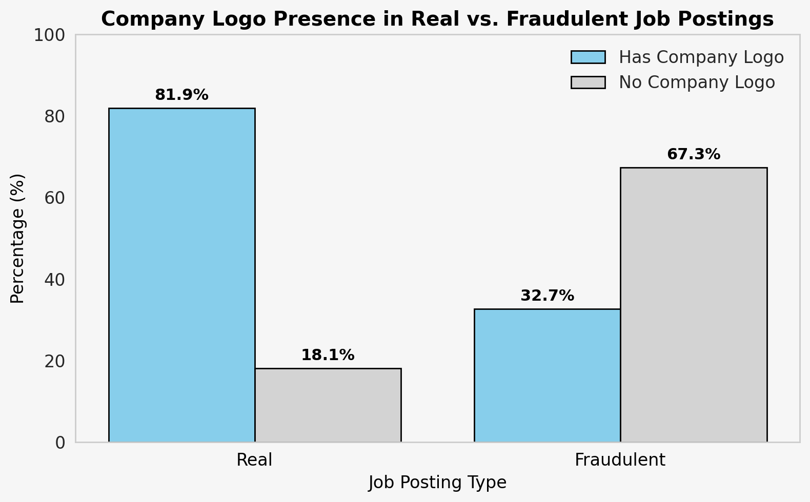

Slide 14
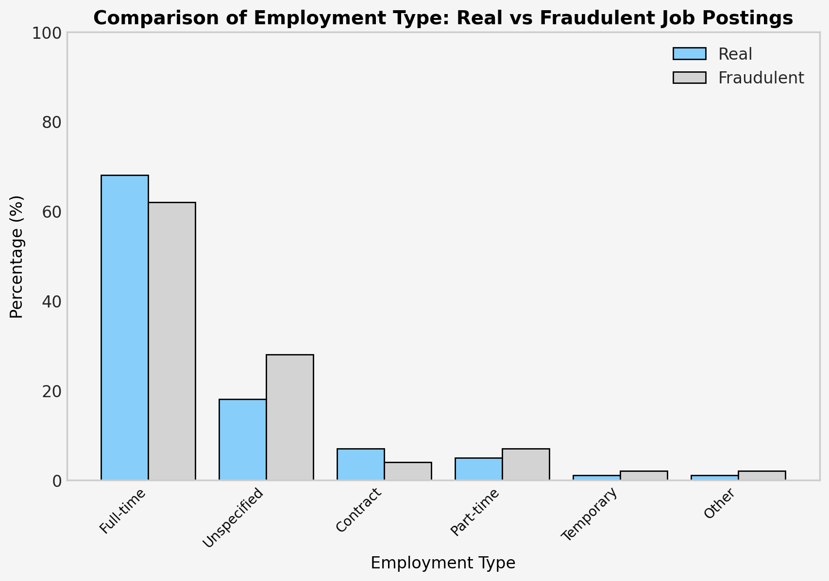

Slide 15

Data
Preparation
Data Modification
Textual Data → Numeric Values
Column | Change Process
Job Description | String Length
Required Education | Ordinal Coding
Employment Type | Ordinal Coding
Industry | One Hot Encoding
Department | One Hot Encoding
Salary | One-Hot Encoding
Notes:
Before begin with fitting and revising our model, it was imperative that we modify several columns so that they would be compatible with different sklearn models.
The first of these was simple, just taking the length of the job description of each row.
Both Required Education and Employment Type used Ordinal Encoder from the Preprocessing folder in SKLearn library. This was done because education follows a logical hierarchy and employment, while one is not necessarily better than the other, they do follow an order.
For the industry and department, we used One Hot Encoding to avoid unintentionally ranking departments/industry against each other and creating unintended bias in our model.

Slide 16
Initial Model Creation
Logistic Regression
Accuracy: 95%
Threshold >= 0.3:
Department Not Provided (0.329)
Employment Encoded (0.314)
Threshold >= 0.1:
Department Not Provided (0.33)
Job Description Length (0.240)
Employment (0.31)
Education (0.15)
Industry Not Provided (0.219)
Threshold >= 0.05:
Department Engineering (0.07)
Department Not Provided (0.33)
Job Description Length (0.24)
Has Company Logo (0.06)
Has Questions (0.07)
Employment (0.31)
Education (0.15)
Industry Finance (0.06)
Industry Not Provided (0.22)
Notes:
The first steps in building our model was splitting our data up into our train, validation, and test sets and ensuring no NaN values were included in input columns. We could
However the meat and potatoes of model building was starting out with Logistic Regression as our model. Now at first glance, this model was doing pretty well in predicting when a job listing was genuine versus fraudulent. We tested our model model on the validation set at three different coefficient thresholds to determine if the accuracy shifted and one threshold was better than the other. Across all three of these coefficient thresholds, our accuracy continued to hover around 95%
However, we all felt that this was a little too good to be true. So we decided to run a confusion matrix

Slide 17
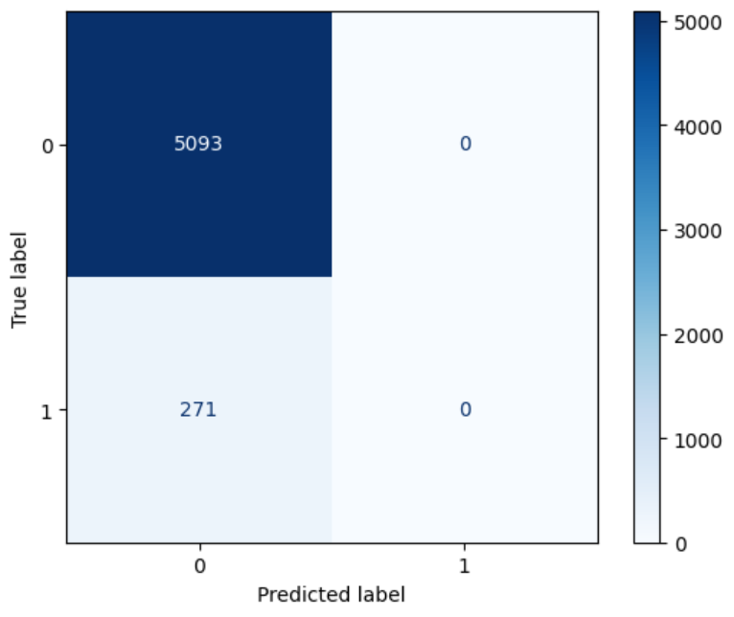
Notes:
A confusion matrix is a table used to evaluate the performance of a classification model, comparing the actual labels and the predicted labels, showing how well the model classifies each category.
As we can see from this matrix, our Logistic Regression is just assuming all of the jobs are genuine, despite around 5% of our dataset being fraudulent.
Obviously, this is not the result we want from a predictive model designed to detect fake job listings.

Slide 18
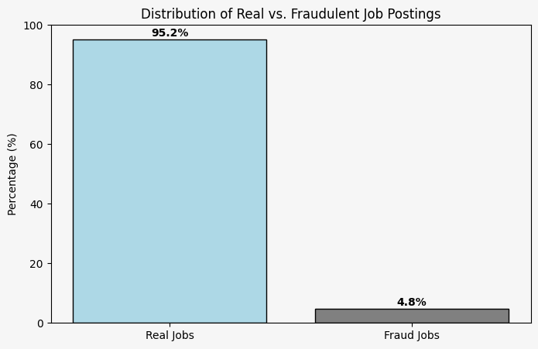
Our main error: Not balancing our dataset!
Notes:
Our model did not have a balanced number of columns, which resultently caused inconsistency behind real job posting accuracy

Slide 19
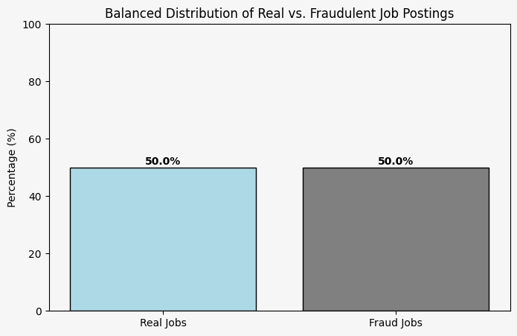
Version 2- Balancing the scales
Notes:
This is where we balanced our dataset in order to move on with our predictive model

Slide 20
Version 2- Balancing the scales
Fraudulent Job Signals
Real Estate Industry (+1.66)
Engineering Department (+1.42)
Finance Industry (+1.09)
Real Job Signals
Education Industry (-1.49)
Electronics Industry(-1.85)
Company Logo (-2.66)
Unexpected Issue: Multicollinearity
* Many columns had similar accuracy scores
* Calculated the Variance Inflation Factor (VIF) to identify these features

Slide 21
Version 3- Accounting for VIF
VIF analysis revealed that some features were too similar, causing collinearity in Industry and Department columns.
Cause: An extra reference column in one-hot encoding created a dummy variable trap.
Fix & Model Impact
Accuracy dropped to 50% due to information loss.
Model over-relied on dummy variables, reducing generalization

Slide 22
Version 3- Accounting for VIF
Logistic Regression
Accuracy: 78%
Fraudulent Job Signals
Engineering Department (+1.06)
Administrative Department (+0.91)
Real Job Signals
Company Logo (-2.15)
Education Industry (-0.81)

Slide 23
Version 4- Removing highly correlated columns
Version A: Dropping Standardized Industry Accuracy = 49%
Threshold Accuracy
Accuracy: 76%
Fraudulent Job Signals
Real Estate Industry(+1.31)
Finance Industry (+1.05)
Real Job Signals
Company Logo (-2.24)
Education Industry (-1.47)
Notes:
Even after fixing one-hot encoding, many columns were still highly correlated, impacting model performance.

Slide 24
Version 4- Removing highly correlated columns
Version B: Dropping Standardized Industry Accuracy = 46%
Threshold Accuracy
Accuracy: 79%
Fraudulent Job Signals
Engineering Department (+1.31)
Real Job Signals
Company Logo (-2.12)

Slide 25
Version 4 - Accuracy Metrics
Dropping Department
True Positive Rate (TPR) - 64%
True Negative Rate (TNR) - 79%
False Positive Rate (FPR) - 21%
False Negative Rate (FNR) - 36%
Precision - 78%
Dropping Industry
TPR - 66%
TNR - 87%
FPR - 34%
FNR - 13%
Precision - 83.5%
Dropping industry significantly improves model reliability

Slide 26
Version 5 - Utilizing PCA
Principal Component Analysis (PCA) - technique used to reduce the number of creatures in a dataset while retaining as much important information as possible. Achieved by transforming original features into smaller sets of new variables called principal components, which capture most significant patterns in the data.

Slide 27
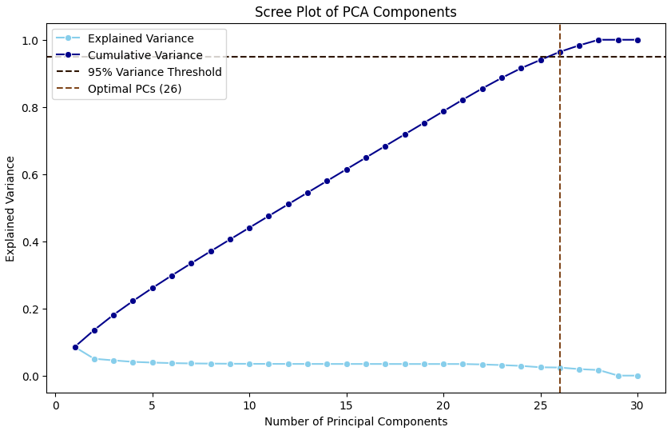
Version 5 - Utilizing PCA
26 Principal Components

Slide 28
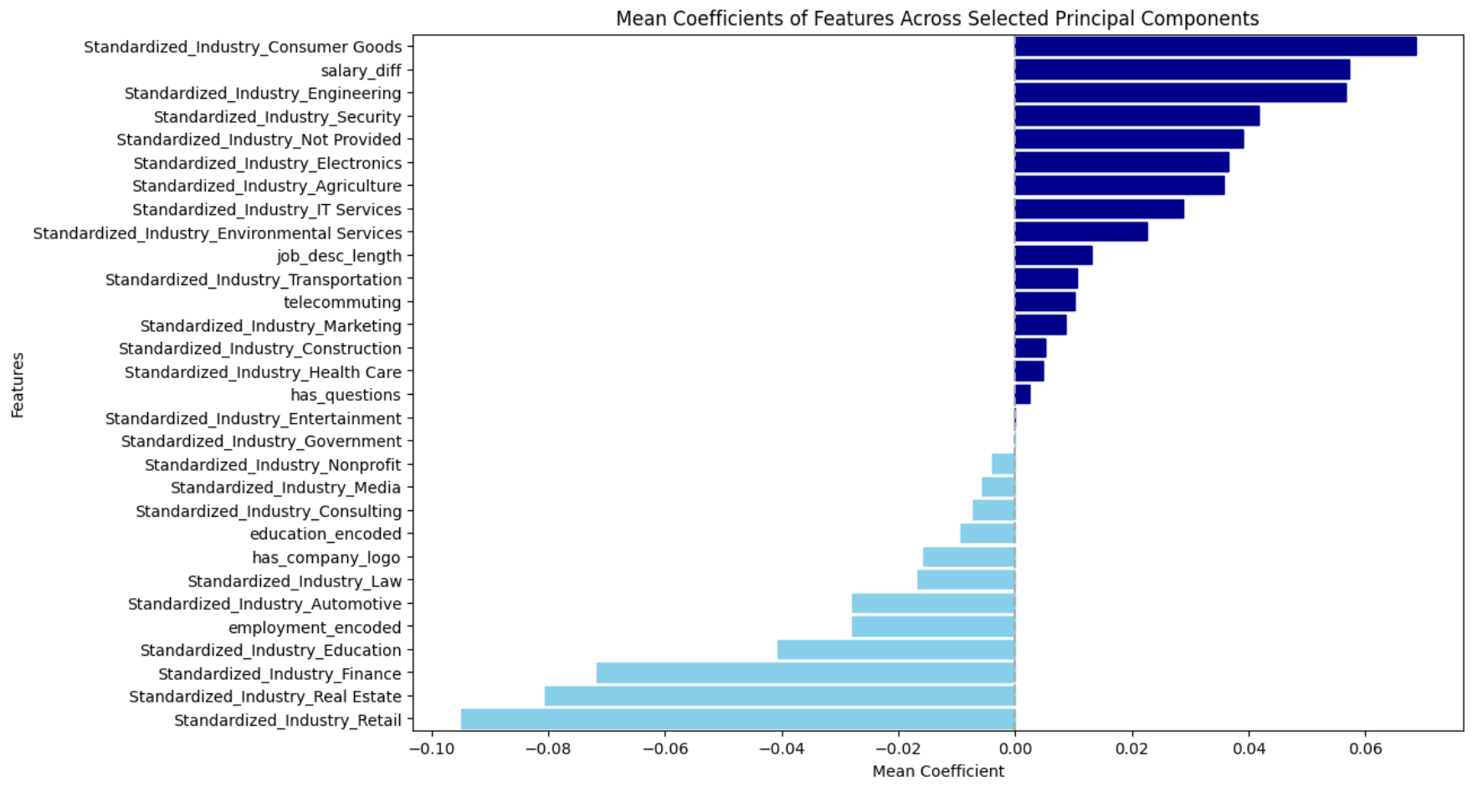
Version 5 - Utilizing PCA

Slide 29
Version 5 - Accuracy Metrics
Validation Set (23 PCs)
TPR -68%
TNR - 82%
FPR - 18%
FNR - 32%
Precision - 81%
Testing Set (23 PCs)
TPR - 69%
TNR - 78.5%
FPR - 21%
FNR - 31%
Precision - 77.5%
Model generalizes, consistently performs, & has room for improvement!

Slide 30
Complete Model
V2
Balance Data Sets:
50% Accuracy for Model Prediction
Similar Accuracy Score
V3
VIF:
VIF analysis revealed collinearity in Industry and Department due to an extra reference column in one-hot encoding (dummy variable trap).
V4
Removing Highly Correlated Columns:
Eliminated the Standardized Industries to increase overall accuracy
Increased overall job posting Accuracy to 79%
V3
V5
Utilizing PCA:
Utilizing Principal Components to increase overall model accuracy
Notes:
So what are our next steps for building an accurate model? The first step was to create a balanced data set with an equal number of fraudulent and genuine jobs. The unfortunate draw back of this that we aren’t utilizing a large chunk of our dataset. Recall that our original dataset included 17,880 listings. In order to maximize our utilization of our dataset, we implemented warm start, which essentially allows our model to retain the information it gained from previous predictions when making subsequent predictions.
With these two changes, we will retrain and validate our model, utilizing a confusion matrix once again in order to ensure that our model it’s just super super confident in predicting all of the jobs are fake.
We will see a decrease in our accuracy from our previous 95% using this altered approach but we’d rather see a “worse” model that’s fairly confident it’s making the right predictions and have it actually make correct predictions than a model that’s certain it’s making the correct prediction and getting it wrong every time.

